Slide 2
Voiceprint speaker verification and emotion classification
Preliminary results

Slide 3
Contents
Preprocessing
Selecting voiceprint pairs
Speaker verification
Emotion classification

Slide 4
Preprocessing
~130,000 speeches with misaligned timestamps
Automatic realignment with diarisation and ASR by KBLab
Add metadata such as age and name
(Quality) filtering, among others:
Poor alignment
>= 80 sec long speeches
3+ speeches by a speaker in a year
10+ consecutive years of speeches per speake
Create timestamps for full speeches, and 60, 30, 10, 5, 3, and 1 seconds
First and last 10 seconds ignored before creating timestamps
Deals with final misalignment issues

Slide 5
Selecting voiceprint pairs
3 settings
Within speaker within age
Within speaker across age
Across speaker (any age)
Procedure
Per speaker per age 3 pairs are set up
Since each speaker has 3+ speeches, so 3 unique pairs possible

Slide 6
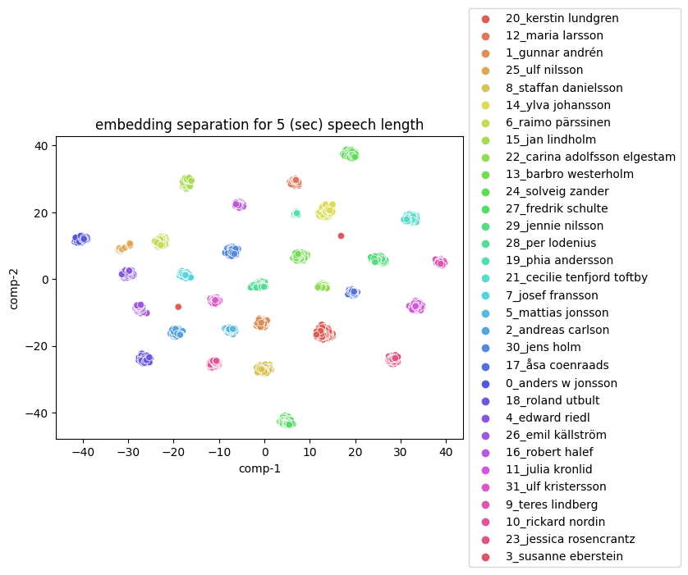
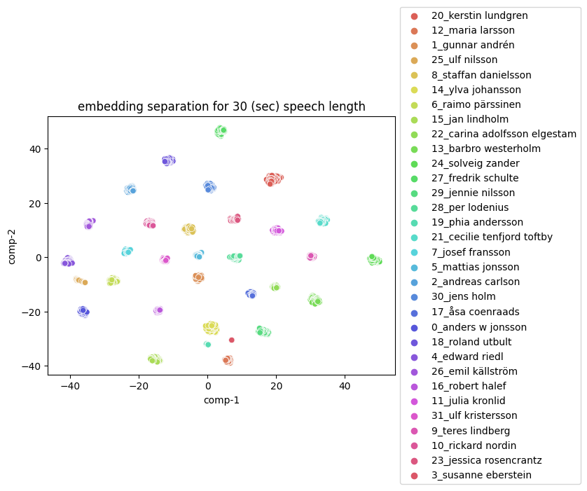
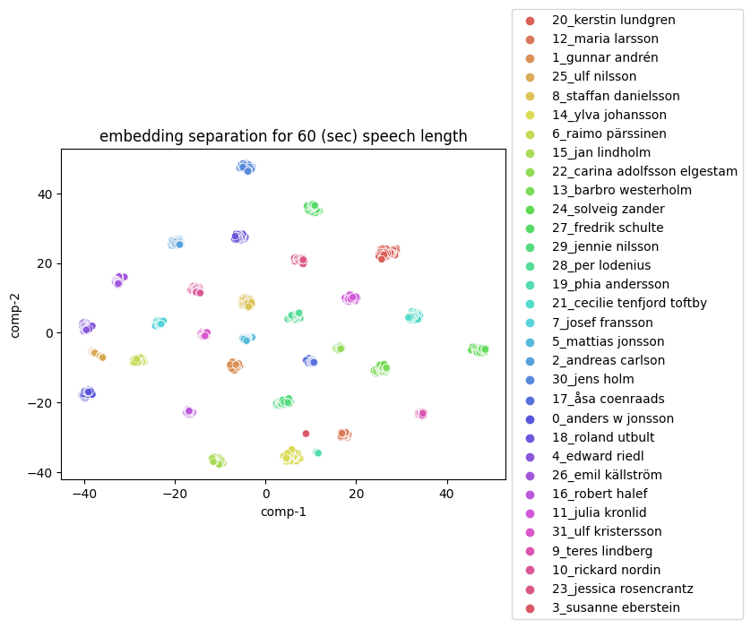
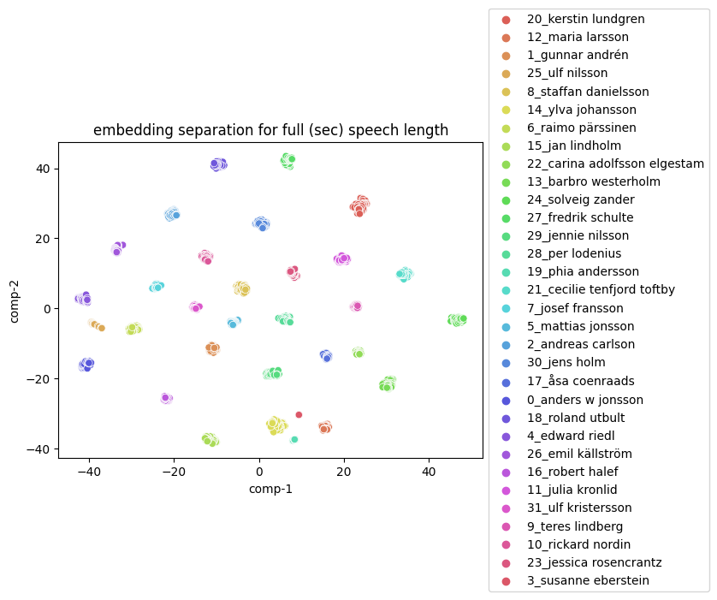
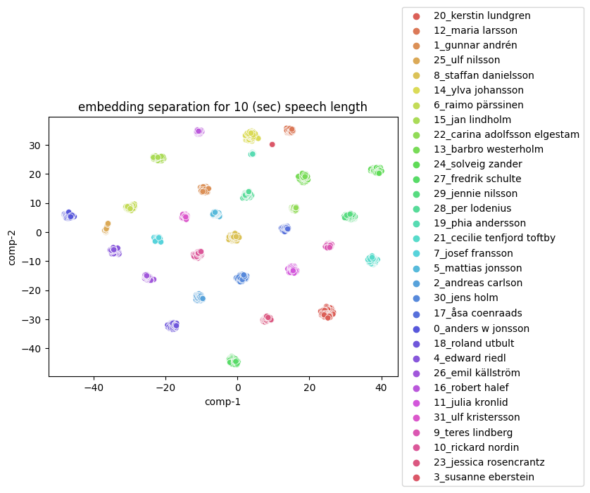
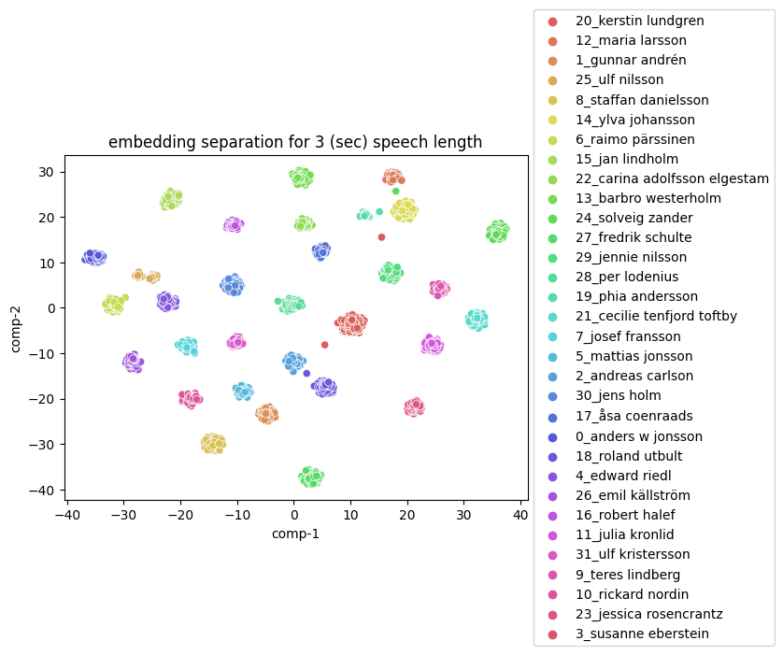
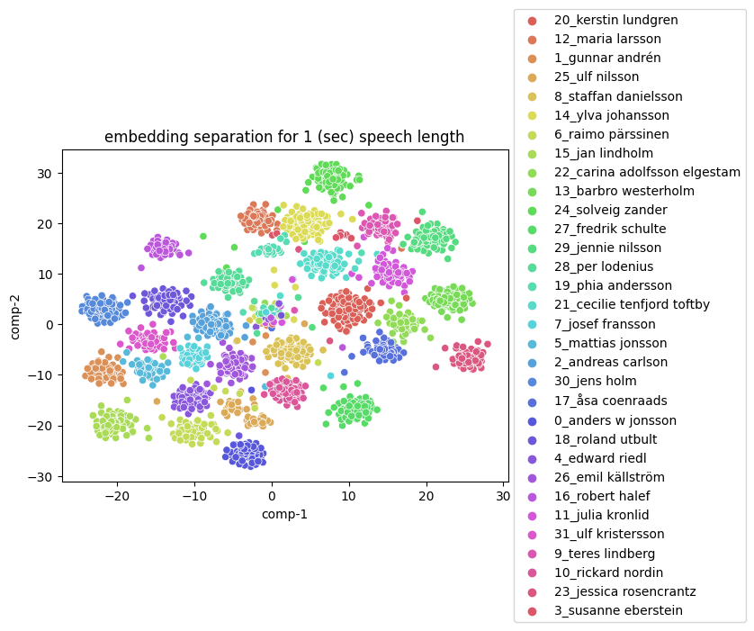
Speaker verification

Slide 7
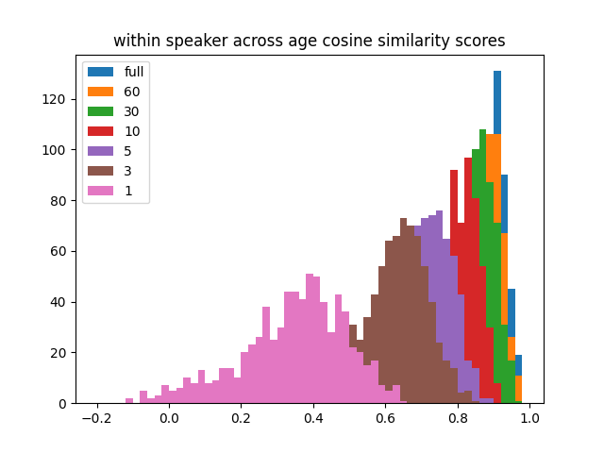
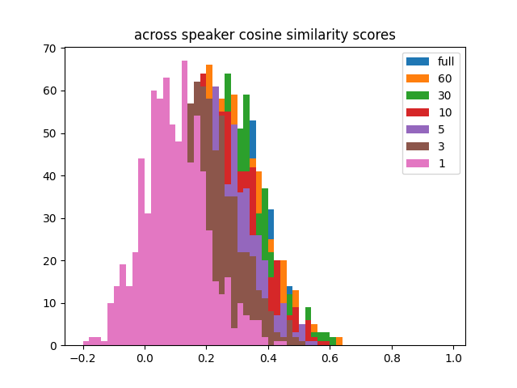
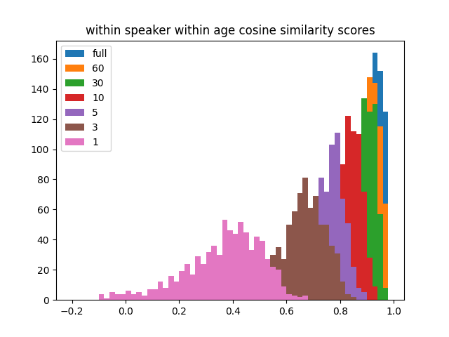
Speaker verification

Slide 8
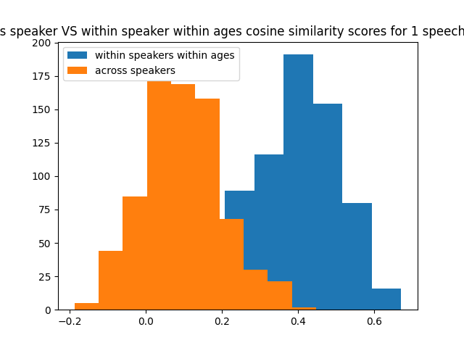
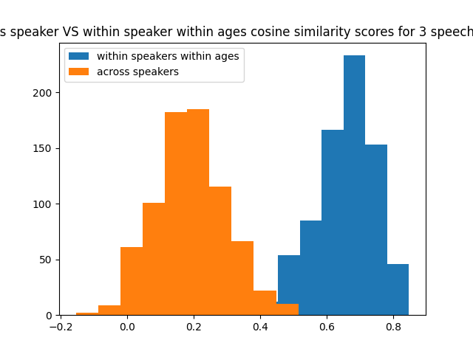
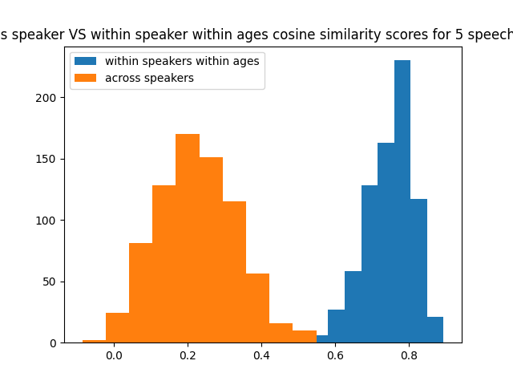
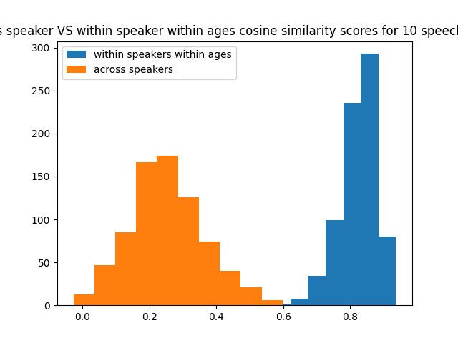
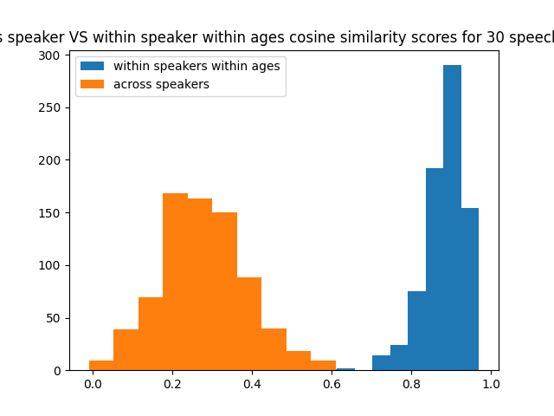
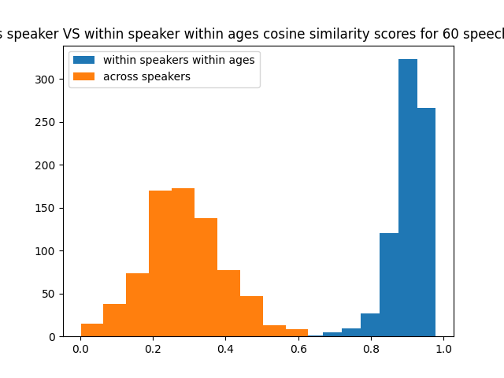
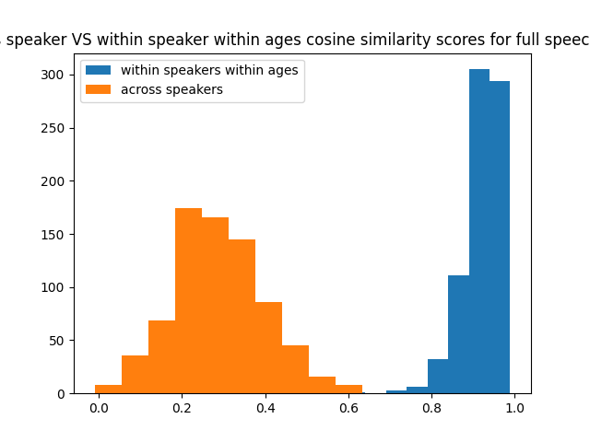
Speaker verification

Slide 9
Emotion classification
Dataset
10 Chinese, 10 English speakers
4 emotions (Happy, Neutral, Sad, Angry)
350 utterances per emotion
=> 28000 utterances in total

Slide 10
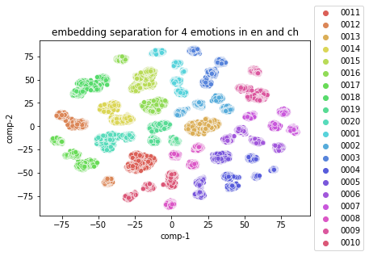
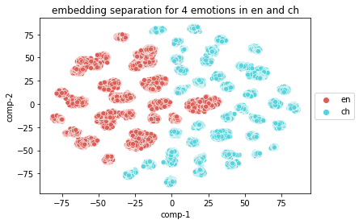
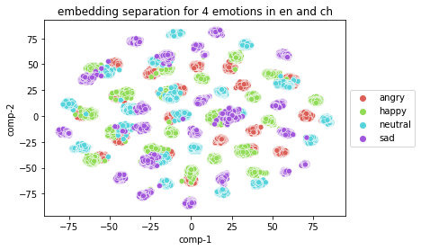
Emotion classification (contd.)

Slide 11
Emotion classification (contd.)
Classifier
3-layer linear classifier, hidden size = 1024
Training on English
92.9% English accuracy, 55.2% Chinese accuracy
Training on Chinese
46.6 English accuracy, 96.9 Chinese accuracy
Training on both
78.0% English accuracy, 83.8 Chinese accuracy

